Slide 1
HMIS Data Quality: Telling the Right Story

Slide 2
PRESENTERS
Brittany Coronado
Owner
Informed By Data LLC
Gaither Stephens
CEO
Gaither Dynamic

Slide 3
CoC and ED Collaboration Case Studies:
Data Quality Basics
HMIS Administrator Tips & Tricks
Understand the Value of your HMIS Administrator
Questions and Answers
Resources

Slide 4
Data Quality Basics

Slide 5
Definitions:
Data: facts and statistics collected together for reference or analysis.
Data is the plural form of the Latin word datum. Datum means “a fact”.
Information: facts provided or learned about something or someone.
In other words, information is the content placed withing the HMIS database. By applying contextual analysis, this data becomes information. Data without information has no meaning.
Quality: the standard of something as measured against other things of a similar kind; the degree of excellence of something.
In other words, data quality measures how well suited a data set is to sever its specific purpose. Measures of data quality are based on data quality characteristics such as accuracy, completeness, consistency, validity, uniqueness, and timeliness.
Notes:
Brittany

Slide 6
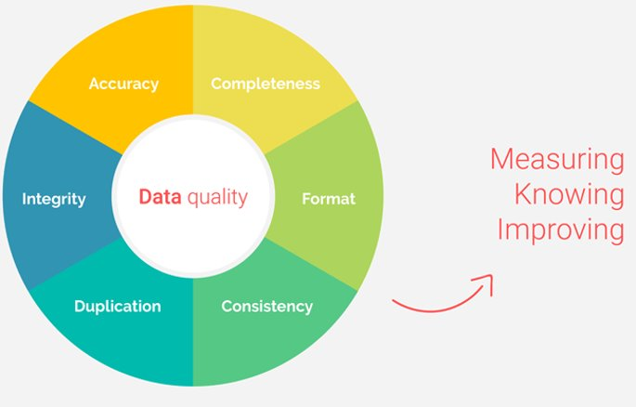
What is Data Quality?
Source: https://www.passionned.com/bi/data-quality/
Notes:
Gaither

Slide 7
What is Data Quality? -Explained
Completeness: has all the data been entered completely? Your process will also benefit from this and run more smoothly.
Accuracy: consider, for example, income, old addresses or spelling errors in names and addresses. Information may be complete, but is it correct?
Format: does the data comply with rule? Consider the formatting of phone numbers or social security numbers.
Consistency: when recording someone's length of time homeless, do you always use the same definition or ask the same way?
Duplication: customers often appear multiple time in files. Often, the information in various records are different.
Integrity: you can clean data to make it more accurate, don’t cherry pick or change it to make it look better.
Notes:
Gaither

Slide 8
Data Quality Challenges:
CoC’s Operate Independently: some CoC’s have single county implementations and others have multi could implementations. Currently, Florida has 27 unique CoC’s that interpret rules and guidelines differently. This places a challenge on the accuracy of statewide data and national data.
HUD Inconsistencies: typically, HUD publishes new ‘data standards’ around October of each year. This changes definitions of questions meaning old data should be interpreted differently. Ex: The point in time established a manual back in 2014 where PIT data drastically dropped nation wide due to more standardization.
HMIS Admin Understanding: HMIS Administrators are required to comprehend ALL different program types (SSVF, HUD-VASH, ESG, etc.). Each funding stream has different requirement and sometimes different data elements and projects that need to be collect and reported differently.
Vendor Flexibility or Custom Reporting Capability: not every HMIS administrator is a coder or a website builder. Some reports call for information that is not easily gathered from the current data “canned reporting” such as the Annual Performance Report (APR)
Notes:
Brittany

Slide 9
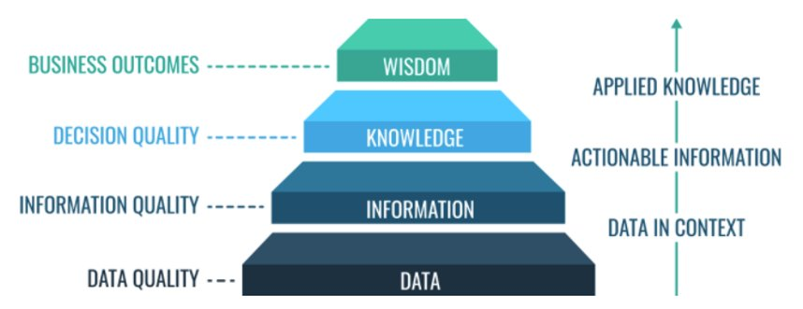
Why Does Data Quality Matter?
Source: Data Quality - What, Why, How, 10 Best Practices & More - Enterprise Master Data Management • Profisee
Notes:
Brittany

Slide 10
Why Does Data Quality Matter?
Poor Data Quality: has a cumulative effect that can cascade through your system affecting reports, making jobs more difficult, and ultimately hurting clients.
Good Data Quality: important for system wide reporting like System Performance Measures and the Longitudinal Systems Analysis (LSA). This leads to more accurate analysis and allows organizations and their stakeholders to make more informed decisions.
Notes:
Gaither

Slide 11
What are Some Solutions for Data Quality?
Data Literacy:
All HMIS Administrators, End Users and Community Stakeholders must be data literate.
Recognize the usefulness, interrogate the reliability, discover meaning, make decisions, and communicate findings. All should be done in an ethical manner.
Data Quality 3 Offenders:
People, process and technology
Implement Tools:
Tools and training are part of the solution. Providing real-time guidance, cheat sheets, one-sheets, and frequent trainings can help improve overall data quality.
Conduct Data Quality Gaps Analysis:
Generate reports to show “current state” and determine desired “future state”
Develop “Business Rules”
Current State
GAP
Desired State
Notes:
Brittany

Slide 12
Develop Business Rules for HMIS:
Shelter Capacity Rule:
Emergency Shelter A has 100 beds, reports should not exceed bed capacity.
If bed capacity report indicates 224 beds used, reach out to shelter (possible overflow or data entry error)
Project Intended Purpose Rule:
If a project is to serve veteran households, then 100% of head of household should be a veteran.
If report generates non-veteran head of household members, check to ensure there is a qualifying veteran member.
Project Eligibility Rule:
ESG Street Outreach serves unsheltered homeless, 100% of adults served should indicate “residence prior to entry (where did you sleep last night)”: place not meant for habitation.
If report states differently, investigate the information.
Current State
GAP
Desired State
Notes:
Brittany

Slide 13
More HMIS Business Rules:
Housing Move-In Date Rule (HMID):
A move-in date must occur on or after the client’s enrollment date.
The date must also occur between the enrollment date and exit date.
Multiple Project Rule:
Client’s can be in two projects at the same time, with overlapping dates.
Client’s can not be in two contradicting programs simultaneously (street outreach and emergency shelter).
Date of Service Rule:
Services provided by projects must occur within the start and end date of the program enrollment.
Project Exit Rule Related to Contacts:
For street outreach, if clients do not communicate with a case worker in 90 days, they should exit the program. (contacts is now defined as current living situation)
Notes:
Gaither

Slide 14
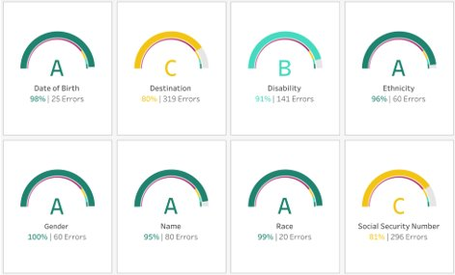
Data Quality Grading:
Letter grades are simpler to understand
Letter grades convey a universal message
Easier to digest than percentages
Recommended Grading Scale:
A >= 95%
B >= 90%
C >= 85%
F < 85%
Notes:
Gaither

Slide 15
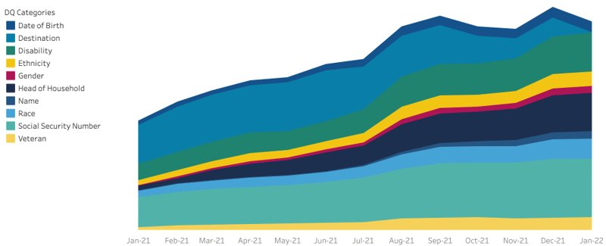
Visualize Data Over Time:
Notes:
Gaither

Slide 16
Contextualize Data Entry Assistance:
V.S.
Notes:
Gaither

Slide 17
Real Life Stories
Data Quality
Completeness
Format
Consistency
Duplication
Integrity
Accuracy
Notes:
Brittany: Accuracy, Integrity, Completeness: as a case manager for HPRP, homeless prevention and rapid re-housing I received the cases from the previous case worker and had to complete data entry on a client that I never talked to. When doing so, I noticed the “Non-cash benefit” Food stamp question was blank. I tried to review case notes and couldn’t find any detail that indicated “yes/no”. When I asked my boss, I was informed, “they are a mother with 4 kids, they more than likely have food stamps, mark yes.” I realized this wasn’t the right thing to do so I called the client and asked. It turned out at the point of entry they did not have food stamps and later acquired food stamps.
Gaither:
Does anyone else have stories they’ve encountered or have questions on how to deal with any of these areas?

Slide 18
HMIS Administrator
Tips & Tricks

Slide 19
Housing Inventory Count (HIC) Data Quality:
What is the HIC:
The Housing Inventory Count (HIC) counts the number of beds and units dedicated to serving people who are experiencing homelessness. On the night of the count, you are able to determine the rate of utilization based on the "year-round" beds that are dedicated to the population.
Determine Allowable Beds:
Establish what beds should be counted and make sure data is available to fill out the HIC.
HIC reports produced by HMIS:
Recording the Housing Move-In Date (HMIDs) before entry into RRH program or after the exit date may cause people not to appear on the HIC report.
Notes:
Gaither

Slide 20
Point in Time Data Quality (PIT) TIPS:
Standardize the Survey HUD Required Data:
Adding additional questions causes survey fatigue.
If you ask additional questions, do so at the END of the survey AFTER asking all the HUD required questions.
User Friendly Questions for Those Conducting Surveys:
You can, however, edit the questions for surveyor’s ease of conversation. It’s important that when doing this the meaning of the questions doesn’t change.
Technology Based Survey’s:
If possible, utilize technology when conducting the PIT, this minimizes duplicative error and ease of counting.
Notes:
Gaither

Slide 21
Point in Time Data Quality (PIT) TIPS:
Additional Sections to Include:
Notes Section: This allows for additional information that can help cypher information that doesn’t make sense.
Record location and time, even if it’s generic.
Provide Adequate Training:
Ensure that PIT volunteer training has a sensitivity component.
Have each volunteer practice giving the survey at least once before conducting interview in the fields.
Conduct the PIT in the smallest window of time possible to minimize the possibility of county people multiple times.
Notes:
Gaither

Slide 22
System Performance Measure Data Quality TIPS:
Accuracy of Information Affects Measures
Artificially inflating permanent housing placement can increase returns to homelessness.
Review your Average and Median Numbers
Large discrepancies between the median length of time and the average length of time means there are probably some outliers in the data.
Run Reports Often
Running your reports frequently, (monthly or quarterly), don't want until HUD and the State ask for them.
Make Corrections for Client Level Data
Exit street outreach clients with no service or contact in 90 days.
Record income changes (minor increases count), if someone receives federal income like SSDI, they typically see an annual increase.
Notes:
Brittany

Slide 23
Longitudinal Systems Analysis (LSA) Data Quality TIPS:
HUD CSV Files:
Look for blanks
Client Level Data Quality:
Make sure each household has 1 and only 1 head of household.
Project Level Data Quality:
Ensure your programs are created correctly.
HUD and Vendors tie a lot of reporting to the actual build of the programs in your database.
Notes:
Gaither

Slide 24
Data Quality Pyramid:
Hidden Data Problems
Report Specific Data
Logically Broken Data
Universal Data Elements
Notes:
Gaither

Slide 25
Real Life Stories
Tips & Tricks
Housing Inventory Count
Point in Time Count
System Performance Measures
Longitudinal Systems Analysis

Slide 26
Understand the Value of
Your HMIS Administrator
Notes:
Ask about HMIS admin role?

Slide 27
Key Responsibilities of the HMIS Lead:
Project Management and Coordination:
Associated with managing and operating the HMIS.
Data Analysis:
Associated with HMIS Data analysis and reporting.
Programming:
Associated with and internal programming related to HMIS.
Technical Assistance and Training:
Associated with developing and conducting training for HMIS.
Administrative Staff Support:
Associated with support HMIS staff .
Shared Responsibilities
HMIS Governance
HMIS Technical Standards
HMIS Security Standards
HMIS Data Quality Standards
Notes:
Brittany
Project Management:
The core ability that is necessary to successfully bring a project from start to finish. Good communicator, strong leader, and effective problem solver.
Data Analysis:
Process of systematically applying statistical and/or logical techniques to describe and illustrate, condense and recap, and evaluate
Programming:
The process or activity of writing computer programs, coding
Training:
The act of teaching a person a particular skill or type of behavior
Administrative Support:
To give assistance in running the HMIS business operations.

Slide 28
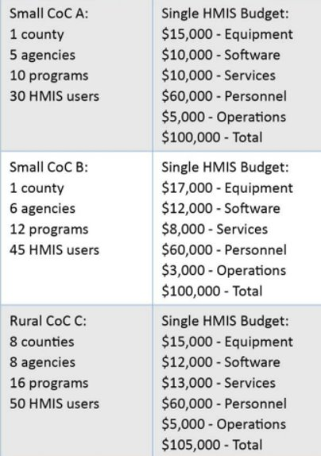
HUD Presented Funding Model from 2011:
Each CoC is responsible for all aspects of HMIS with 1 FTE
This funding model was presented before:
HMIS was required to conduct system wide performance measures
HMIS was required to conduct system wide LSA reporting
HMIS was required to report on the DCF and CoC unified application.
Source: https://files.hudexchange.info/resources/documents/HMISBudgetingStaffingTookit.pdf
Notes:
Brittany

Slide 29
Do you Take your Data Seriously?
CURRENT IMPLEMENTATION PLAN |  |  |  | ANTICIPATED HMIS GROWTH OVER 1-3 YEARS
Current HMIS Goals: |  |  |  | 1-3 Year Goals:
# Users: |  |  |  | Anticipated Users:
Total Annual Budget: |  |  |  | Total Budget Needed:
Roles and Responsibilities | Tasks Associated with Roles | Who is Responsible? | Current FTE | Future Roles and Responsibilities | Tasks Associated with Roles | What skill sets will you need? | Anticipated FTE?
System Administration: |  |  |  | 1.)
Project Management: |  |  |  | 2.)
Governance: |  |  |  | 3.)
Vendor Relations and Evaluation: |  |  |  | 4.)
Training and Technical Support: |  |  |  | 5.)
Data Analysis and Reporting: |  |  |  | 6.)
Source: https://files.hudexchange.info/resources/documents/HMIS-Staffing-and-Resourcing-Toolkit.pdf
Notes:
Gaither

Slide 30
Advocate for your HMIS Administrator:
Talk to your HMIS Administrators:
ask them if they are overwhelmed.
Know their skills and level of capacity.
Just because they are willing to do it all, doesn’t mean that they should.
Advocate for funding:
Support the skills they are missing
Notes:
Gaither

Slide 31
We Encourage you to be Curious:
HMIS Administrators: | End Users & Stakeholders
Know the story you are trying to tell | If you aren't aware, ask what story is being told
Know the data being presented and how you are presenting it | Ask what data is being presented and how it was gathered
Know the agenda behind the information being presented | Notice the visualization and they story they depict
Ask yourself, do I trust the data being presented | Ask yourself, do I trust the data being presented
Ask yourself, will this data help other make decisions | Ask yourself, how does this data impact decisions I'm making
Ask yourself, am I bias to any information being presented | Be vocal and inform what you would like to see (what you did or didn't understand)
Notes:
Brittany

Slide 32
Questions & Answers

Slide 33
Resources

Slide 34
We all need all the help we can get!
HMIS Data Exchange Resources
HMIS Standard Reporting Terminology Glossary
FY 2022 HMIS Data Standards
HMIS Data Standards
CoC Alliance
Subscribe to HUD mailing lists (HMIS!!!)
HDX, HDX 2.0, SAGE, eSnaps
HMIS Lead Series
Join vendor specific support groups!
Notes:
Gaither

Slide 35
THANK YOU!
Brittany.Coronado@InformedByDataLLC.com​
Gaither.Stephens@GaitherDyn.com​

