Slide 1
Innovative Practices in VHA Homeless Programs
VHA Homeless Program Office
Shawn Liu, LCSW, VHA-CM
Program Analyst, Clinical Operations
VHA Homeless Program Office

Slide 2
Innovative Practices Workgroup
The VHA Homeless Program Office’s Innovative Practices Workgroup is tasked with identifying and disseminating emerging, promising, leading, and best practices across homeless program operations.
The goal is to improve the adoption of these practices by developing a library of innovative practice white papers.
Focus on practices that are:
Relevant.
Concrete.
Practical.
Implementable.

Slide 3
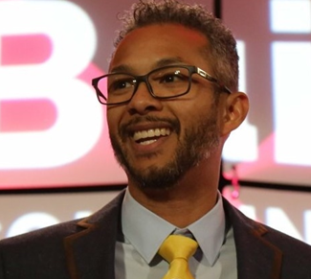
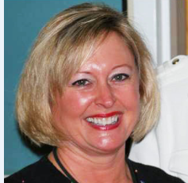
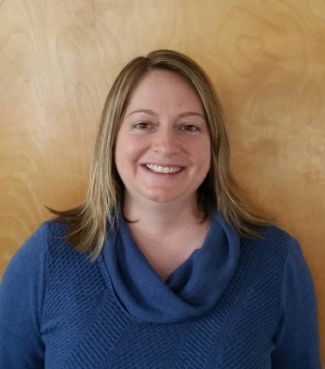
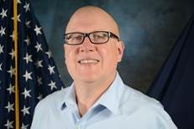
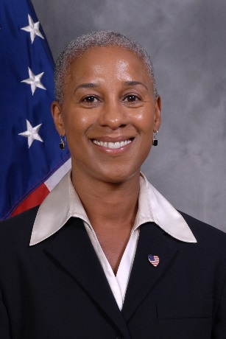
Innovative Practices Workgroup Members
Shawn Liu, LCSW, Program Analyst, Clinical Operations
Allison Bond, LCSW, CRRC & HCHV Outreach National Program Manager
Carma Heitzmann, PhD,
National Director, Homeless Veterans Community Employment Services
Deborah Lee, LCSW,
HUD-VASH Regional Coordinator
Michael Wehrer, MSW, LCSW,
Homeless Program Supervisor
Erie VAMC

Slide 4
Shreveport – Integrating the Community Employment Coordinator into Homeless Services
Integrating the VA Community Employment Coordinator into almost all aspects of the community’s homeless services system has lead to employment becoming a primary focus in all activities.
This is most apparent in the addition of employment and income planning during CES case conferences.

Slide 5
San Francisco – HQS Toolbox
Peer Support Specialists partnered with SSVF grantees to stock actual physical toolboxes with equipment and supplies to address the most common reasons why HQS inspections fail.
Within 6 months of implementing this innovation, first-time inspection pass rates to surged from 20% to over 90%!

Slide 6
Seattle – Landlord MOUs
HUD-VASH staff in Seattle partnered with the King County Housing Authority and utilized memoranda of understanding (MOUs) to prioritize access to vacant apartment units for HUD-VASH voucher holding Veterans.
This innovation increased their lease-up rates by 50% over first seven months of implementation.

Slide 7
Seattle – Partnering with the Elks Lodge
VA homeless program staff in Seattle have locally implemented a national Memorandum of Agreement with the Benevolent and Protective Order of the Elks to provide flexible financial assistance for Veterans in King County, WA.
From January 2018 to June 2018, 52 Veterans in Puget Sound received a total of $24,517 through the partnership. Nationally, the Elks have provided 1935 emergency assistance requests to 1320 homeless and at-risk Veterans since the MOA started in 2015, totaling more than $2 million.
Additionally, the Elks have provided 64 grants, worth a total of $284,480 to Lodges in and near the original eight targeted cities.

Slide 8
Chicago – Landlord Engagement
HUD-VASH staff in Chicago developed comprehensive landlord engagement strategies that lead to the identification of 133 new apartment units for use by chronic and long term homeless Veterans.
Pro Tip: When you have your landlord fairs, have every landlord complete a “pledge card” with the number of apartment units they can provide.

Slide 9
Chicago – Presumptive VBA Benefits
Homeless program staff at the Jesse Brown VAMC developed a process to rapidly identify VBA compensation and pension benefit eligibility based on the presence of presumptive medical conditions and military service commendations.
Since October 2017, over 130 Veterans have been able to obtain or increase their VBA financial benefits.

Slide 10
Ann Arbor and Jacksonville – Occupational Therapy
The homeless programs in Ann Arbor and Jacksonville incorporated occupational therapy services into their daily homeless program operations to help Veterans better transition from homelessness to home.
Fun Fact: The OT concept of “Aging in Place” is a lot like Housing First.

Slide 11
Gulf Coast – Disaster Preparedness and Recovery
To prepare for hurricanes and other natural disasters, VISN 16 developed a preparedness and recovery protocol that ensures the safety of homeless program staff and Veterans participating in homeless program services.

Slide 12
Norman – PDSAs
City of Norman conducted a series of monthly action camps designed to continuously improve their community’s homeless services system.
Due to their ongoing improvement efforts, they were able to significantly reduce the number of actively homeless Veterans on their community’s by-name-list.

Slide 13
Los Angeles – Landlord Care
Community partner PATH utilized dedicated support staff to improve the customer service experience for landlords and property owners providing housing to homeless Veterans.
Their comprehensive engagement and support activities resulted in the identification of, on average, 53 new housing units available for rent each month.

Slide 14
Dallas and Albuquerque – Peer Housing Groups
VAs in Dallas and Albuquerque have developed peer-led, self-help groups to help Veterans with high barriers to housing problem solve their challenges and get their own homes.
An implementation guide is available for communities interested in developing their own groups.

Slide 15
Jacksonville, Dallas, and Shreveport – Contingency Management
VA’s in Jacksonville, Dallas, and Shreveport use an evidence-based incentive therapy model to motivate Veterans to maintain sobriety and attend therapy groups.
The more groups Veterans attend, the more prizes they win!

Slide 16
Roanoke – VA Public Affairs
The team at Roanoke have partnered with their VA’s Public Affairs Office to keep their community engaged in issues important to Veteran homelessness.

Slide 17
Palo Alto – PSH for Veterans with a History of Sex Offense
The Palo Alto VA has partnered with the Santa Clara County Continuum of Care to develop up to 80 units of permanent supportive housing for Veterans with a history of sex offence using unrestricted county dollars for housing subsides and VA social workers for clinical case management.

Slide 18
Honolulu – Employment Case Conferencing
Honolulu’s Community Employment Coordinator developed an employment focused case conference (similar to CES case conferencing) to help problem solve employment barriers for homeless and formerly homeless Veterans.

Slide 19
Almost All of Ohio – Effective Balance of State Coordination
VAs and community partners throughout Ohio developed effective practices to coordinate homeless services across 80 counties and nine VA Medical Centers.
By developing their systems to align with the Federal Criteria and Benchmarks, and through ensuring full service coverage for every county, the Ohio Balance of State CoC saw a 23 percent decrease in their 2017 Point-in-Time Count.

Slide 20
All of Virginia – Ending Veteran Homelessness
Dedicated VA staff and community partners all across Virginia developed an amazing system to becoming one of the first states to declare an end to Veteran homeless.

Slide 21
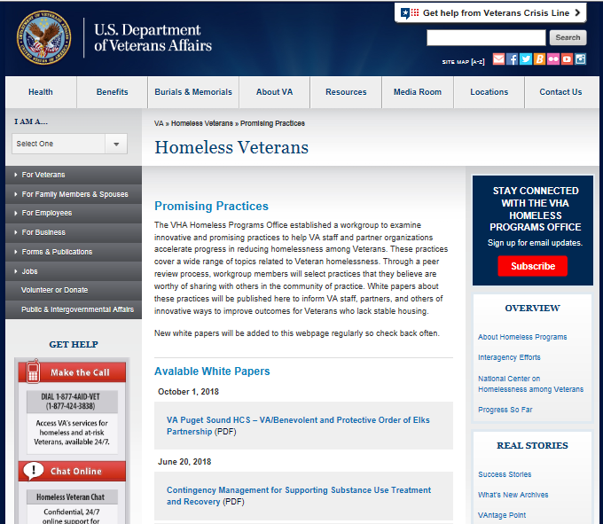
White Papers Available at VA.gov
https://www.va.gov/homeless/promising-practices.asp

Slide 22
Contact
If you would like a copy of the white paper for any of the practices listed here, please send me an email at Shawn.Liu@va.gov.

Slide 23
Discussion:
Which ideas would you like to try?
Which ideas feel out of reach?
What new innovations are you interested in learning about?

